Slide 1
Corral your Kubernetes Clusters
with CAPI Equinix (Cluster API Provider Packet)
Chris Privitere Senior Software Engineer, Equinix

Slide 2
What is Cluster API?

Slide 3
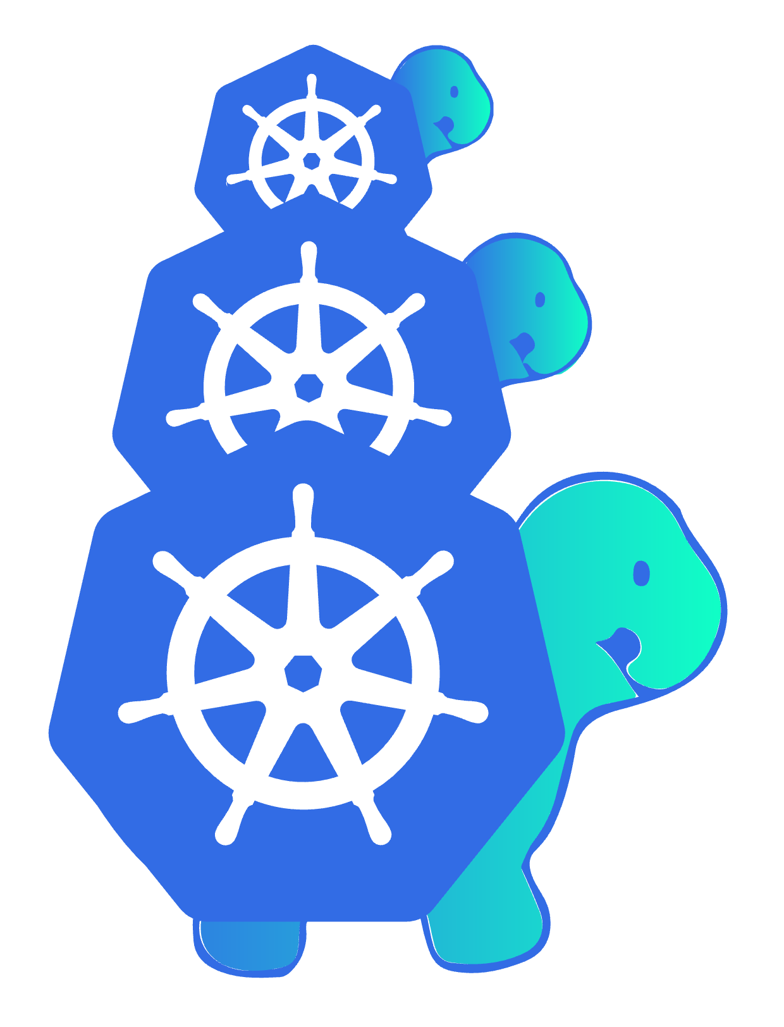
Turtles All The Way Down
“Cluster API is a Kubernetes sub-project focused on providing declarative APIs and tooling to simplify provisioning, upgrading, and operating multiple Kubernetes clusters.”
Clusters managing clusters
Declarative
clusterctl command
Fun mascot

Slide 4
Pre-requisites
Docker
https://docs.docker.com/engine/install/
Kubectl
https://kubernetes.io/docs/tasks/tools/
Kind
https://kind.sigs.k8s.io/docs/user/quick-start/
Clusterctl
https://cluster-api.sigs.k8s.io/user/quick-start.html#install-clusterctl
Helm
https://helm.sh/docs/intro/install/
Argocd
https://argo-cd.readthedocs.io/en/stable/cli_installation/

Slide 5
Quick Install
#!/bin/sh
#Install pre-requisite binaries
curl -fsSL https://get.docker.com | sudo /bin/sh –
curl -fsSLO https://dl.k8s.io/release/$(curl -L -s https://dl.k8s.io/release/stable.txt)/bin/linux/amd64/kubectl
sudo install -o root -g root -m 0755 kubectl /usr/local/bin/kubectl
curl -fsSLo ./kind https://kind.sigs.k8s.io/dl/v0.24.0/kind-linux-amd64
sudo install –o root –g root –m 0755 ./kind /usr/local/bin/kind
curl –fsSLo ./clusterctl https://github.com/kubernetes-sigs/cluster-api/releases/download/v1.8.2/clusterctl-linux-amd64
sudo install -o root -g root -m 0755 clusterctl /usr/local/bin/clusterctl
curl -fsSL https://raw.githubusercontent.com/helm/helm/main/scripts/get-helm-3 | /bin/bash -
curl –fsSLo ./argocd https://github.com/argoproj/argo-cd/releases/latest/download/argocd-linux-amd64
sudo install –o root –g root –m 0755 argocd /usr/local/bin/argocd
#Add user to docker usergroup
sudo usermod –G docker <username>

Slide 6
Deploy a management cluster with kind
$ kind create cluster
Creating cluster "kind" ...
<snip>
You can now use your cluster with:
kubectl cluster-info --context kind-kind
Not sure what to do next? 😅

Slide 7
Initialize the management cluster
$ export PACKET_API_KEY="34ts3g4s5g45gd45dhdh"
$ clusterctl init -i packet
<snip>
Your management cluster has been initialized successfully!
You can now create your first workload cluster by running the following:
clusterctl generate cluster [name] --kubernetes-version [version] | kubectl apply -f -

Slide 8
Install Argo CD
$ helm repo add argo https://argoproj.github.io/argo-helm
"argo" has been added to your repositories
$ helm repo update
Hang tight while we grab the latest from your chart repositories...
...Successfully got an update from the "argo" chart repository
Update Complete. ⎈Happy Helming!⎈
$ helm install argocd argo/argo-cd --namespace argocd --create-namespace
NAME: argocd
LAST DEPLOYED: Fri Sep 6 13:24:59 2024
NAMESPACE: argocd
<etc…>

Slide 9
Verify argocd is running
$ kubectl get pods -n argocd
NAME READY STATUS RESTARTS AGE
argocd-application-controller-0 1/1 Running 0 24s
argocd-applicationset-controller-76565bb86b-s28ns 1/1 Running 0 24s
argocd-dex-server-6dd95b5dc-7wv5p 1/1 Running 0 24s
argocd-notifications-controller-75bd5b6487-5mbsw 1/1 Running 0 24s
argocd-redis-7ddb8856c-mgjff 1/1 Running 0 24s
argocd-redis-secret-init-4vk8q 0/1 Completed 0 34s
argocd-repo-server-6fc9466c8f-qdbbl 1/1 Running 0 24s
argocd-server-58b8cc5974-7vg9k 1/1 Running 0 24s

Slide 10
Export cluster configuration details
export PROJECT_ID=”<YOUR_PROJECT_ID>"
export METRO="da"
export CONTROLPLANE_NODE_TYPE="m3.small.x86"
export WORKER_NODE_TYPE="m3.small.x86"
export SSH_KEY=”<YOUR_SSH_PUBLIC_KEY>"
TIP: You’ll need to use your own PROJECT_ID and SSH_KEY

Slide 11
Checkout your git repo
$ git clone https://github.com/cprivitere/demo-day-clusters
Cloning into 'demo-day-clusters’... …
Resolving deltas: 100% (1/1), done.
$ cd demo-day-clusters
$ mkdir first-cluster
$ cd first-cluster

Slide 12
Generate the cluster config
$ clusterctl generate cluster first-cluster \
--kubernetes-version v1.31.0 \
--control-plane-machine-count=1 \
--worker-machine-count=1 \
--target-namespace=default \
> first-cluster.yaml

Slide 13
Generate the cluster config and commit to git
$ git add first-cluster.yaml
$ git commit -m "feat: add our first cluster“
[main b4ae1b4] feat: add our first cluster
1 file changed, 252 insertions(+)
create mode 100644 first-cluster/first-cluster.yaml
❯ git push
Enumerating objects: 5, done.
…
To https://github.com/cprivitere/demo-day-clusters
59d9c58..b4ae1b4 main -> main

Slide 14
Connect to argocd and register our git repo
$ export ARGOPASSWORD="$(kubectl -n argocd get secret argocd-initial-admin-secret -o jsonpath="{.data.password}" | base64 -d)”
# In another window on the same host
$ kubectl port-forward --address 0.0.0.0 --address :: service/argocd-server -n argocd 8080:443 $ argocd login localhost:8080 --insecure --username admin --password $ARGOPASSWORD 'admin:login’ logged in successfully Context 'localhost:8080’ up
$ argocd app create first-cluster --repo https://github.com/cprivitere/demo-day-clusters --path first-cluster --dest-server https://kubernetes.default.svc --dest-namespace default application 'first-cluster' created

Slide 15
Have argocd check for git updates
$ argocd app get first-cluster
Name: argocd/first-cluster
Project: default
Server: https://kubernetes.default.svc
Namespace: default
URL: https://argocd.example.com/applications/first-cluster
Source:
- Repo: https://github.com/cprivitere/demo-day-clusters
Target:
Path: first-cluster
SyncWindow: Sync Allowed
Sync Policy: Manual
Sync Status: OutOfSync from (b4ae1b4)
Health Status: Healthy
GROUP KIND NAMESPACE NAME STATUS HEALTH HOOK MESSAGE
bootstrap.cluster.x-k8s.io KubeadmConfigTemplate argocd first-cluster-worker-a OutOfSync Missing
cluster.x-k8s.io Cluster argocd first-cluster OutOfSync Missing
cluster.x-k8s.io MachineDeployment argocd first-cluster-worker-a OutOfSync Missing
controlplane.cluster.x-k8s.io KubeadmControlPlane argocd first-cluster-control-plane OutOfSync Missing
infrastructure.cluster.x-k8s.io PacketCluster argocd first-cluster OutOfSync Missing
infrastructure.cluster.x-k8s.io PacketMachineTemplate argocd first-cluster-control-plane OutOfSync Missing
infrastructure.cluster.x-k8s.io PacketMachineTemplate argocd first-cluster-worker-a OutOfSync Missing

Slide 16
Deploy the app
❯ argocd app sync first-cluster
…
This will show a LOT of output.

Slide 17
Check the status of the cluster
$ kubectl get machine
NAME CLUSTER NODENAME PROVIDERID PHASE AGE VERSION
first-cluster-control-plane-fd2jd first-cluster Provisioning 40s v1.31.0
first-cluster-worker-a-c4mgb-k7zw4 first-cluster Pending 43s v1.31.0

Slide 18
What is happening?
Argo is applying the .yaml file to our k8s cluster in the default namespace
Cluster API Provider Packet’s main controller sees the new objects created that specify a new Kubernetes cluster
Cluster API Provider Packet then talks to the Equinix API to create new devices for you
These nodes are given a user-data that installs Kubernetes and Cloud Provider Equinix Metal
Cluster API queries the until they’re online and ready

Slide 19
It’s done
$ kubectl get machine
NAME CLUSTER NODENAME PROVIDERID PHASE AGE VERSION
first-cluster-control-plane-fd2jd first-cluster first-cluster-control-plane-fd2jd equinixmetal://d3b7e052-6be1-4eb5-92c6-2a08bb1d9ccd Running 11m v1.31.0
first-cluster-worker-a-c4mgb-k7zw4 first-cluster first-cluster-worker-a-c4mgb-k7zw4 equinixmetal://5b5df59f-9efd-434d-b90d-773b1f542406 Running 11m v1.31.0

Slide 20
Get the cluster’s kubeconfig
❯ cd ~
❯ clusterctl get kubeconfig first-cluster > ~/k8s.first-cluster.yaml
❯ export KUBECONFIG=~/k8s.first-cluster.yaml
❯ kubectl cluster-info
Kubernetes control plane is running at https://147.28.183.170:6443
…

Slide 21
Check the node status
❯ kubectl get nodes
NAME STATUS ROLES AGE VERSION
first-cluster-control-plane-zgrpp NotReady control-plane 23m v1.31.0
first-cluster-worker-a-2q5bj-qwjg4 NotReady <none> 17m v1.31.0

Slide 22
Install a Network CNI in your new cluster
❯ helm repo add projectcalico https://docs.tigera.io/calico/charts
"projectcalico" has been added to your repositories
❯ helm repo update
Hang tight while we grab the latest from your chart repositories...
...Successfully got an update from the "projectcalico" chart repository
Update Complete. ⎈Happy Helming!⎈
❯ helm install calico projectcalico/tigera-operator --namespace tigera-operator --create-namespace
NAME: calico
LAST DEPLOYED: Thu Sep 5 11:15:05 2024
NAMESPACE: tigera-operator
STATUS: deployed
REVISION: 1
TEST SUITE: None

Slide 23
Verify the CNI started up
❯ kubectl get pods -n calico-system
NAME READY STATUS RESTARTS AGE
calico-kube-controllers-747b55959c-4t86l 1/1 Running 0 4m25s
calico-node-bkzjq 1/1 Running 0 4m25s
calico-node-vh8b7 1/1 Running 0 4m25s
calico-typha-67c88c6878-l88hf 1/1 Running 0 4m25s
csi-node-driver-gz62h 2/2 Running 0 4m25s
csi-node-driver-srzhc 2/2 Running 0 4m25s

Slide 24
Verify your nodes are ready
❯ kubectl get nodes
NAME STATUS ROLES AGE VERSION
first-cluster-control-plane-fd2jd Ready control-plane 17m v1.31.0
first-cluster-worker-a-c4mgb-k7zw4 Ready <none> 11m v1.31.0

Slide 25
Switch back to our management cluster
$ cd ~
$ kind get kubeconfig > k8s.kind-kind.yaml
$ export KUBECONFIG=~/k8s.kind-kind.yaml

Slide 26
Check on our argo app
❯ argocd app get first-cluster
Name: argocd/first-cluster
Project: default
Server: https://kubernetes.default.svc
Namespace: default
URL: https://argocd.example.com/applications/first-cluster
Source:
- Repo: https://github.com/cprivitere/demo-day-clusters
Target:
Path: first-cluster
SyncWindow: Sync Allowed
Sync Policy: Manual
Sync Status: OutOfSync from (b4ae1b4)
Health Status: Healthy

Slide 27
But why are some things “OutofSync?”

Slide 28
Add more nodes
$ cd demo-day-clusters/first-cluster
$ vim first-cluster.yaml
---
apiVersion: cluster.x-k8s.io/v1beta1
kind: MachineDeployment
metadata:
labels:
cluster.x-k8s.io/cluster-name: first-cluster
pool: worker-a
name: first-cluster-worker-a
namespace: argocd
spec:
clusterName: first-cluster
replicas: 3 #← change this from “1” to “3”
$ git add first-cluster.yaml
$ git commit -m "feat: add two more worker nodes"
[main 9a74a25] feat: add two more worker nodes
1 file changed, 1 insertion(+), 1 deletion(-)
$ git push

Slide 29
This is when a PR should be created and reviewed.

Slide 30
Now sync our argo app again
❯ argocd app sync first-cluster
<lots of output again>
Note that the MachineDeployment object says it’s progressing now.

Slide 31
Check out the nodes!
❯ export KUBECONFIG=~/k8s.kind-kind.yaml
❯ kubectl get machines
NAME CLUSTER NODENAME PROVIDERID PHASE AGE VERSION
first-cluster-control-plane-zgrpp first-cluster first-cluster-control-plane-zgrpp equinixmetal://2cad12d2-31ba-44f0-aa67-11093289bada Running 46m v1.31.0
first-cluster-worker-a-2q5bj-84pz5 first-cluster first-cluster-worker-a-2q5bj-84pz5 equinixmetal://3e21d540-7b9b-4296-9c7e-845765fb0b58 Running 4m21s v1.31.0
first-cluster-worker-a-2q5bj-mk7bc first-cluster first-cluster-worker-a-2q5bj-mk7bc equinixmetal://b9ee66e1-78f8-40e2-8467-bb99d836c893 Running 4m21s v1.31.0
first-cluster-worker-a-2q5bj-qwjg4 first-cluster first-cluster-worker-a-2q5bj-qwjg4 equinixmetal://083ae564-222d-44d1-a937-78b120cd2071 Running 46m v1.31.0
❯ export KUBECONFIG=~/k8s.first-cluster.yaml
❯ kubectl get nodes
NAME STATUS ROLES AGE VERSION
first-cluster-control-plane-zgrpp Ready control-plane 43m v1.31.0
first-cluster-worker-a-2q5bj-84pz5 Ready <none> 2m2s v1.31.0
first-cluster-worker-a-2q5bj-mk7bc Ready <none> 106s v1.31.0
first-cluster-worker-a-2q5bj-qwjg4 Ready <none> 38m v1.31.0

Slide 32
We just used declarative continuous deployment to manage our worker node count.

Slide 33
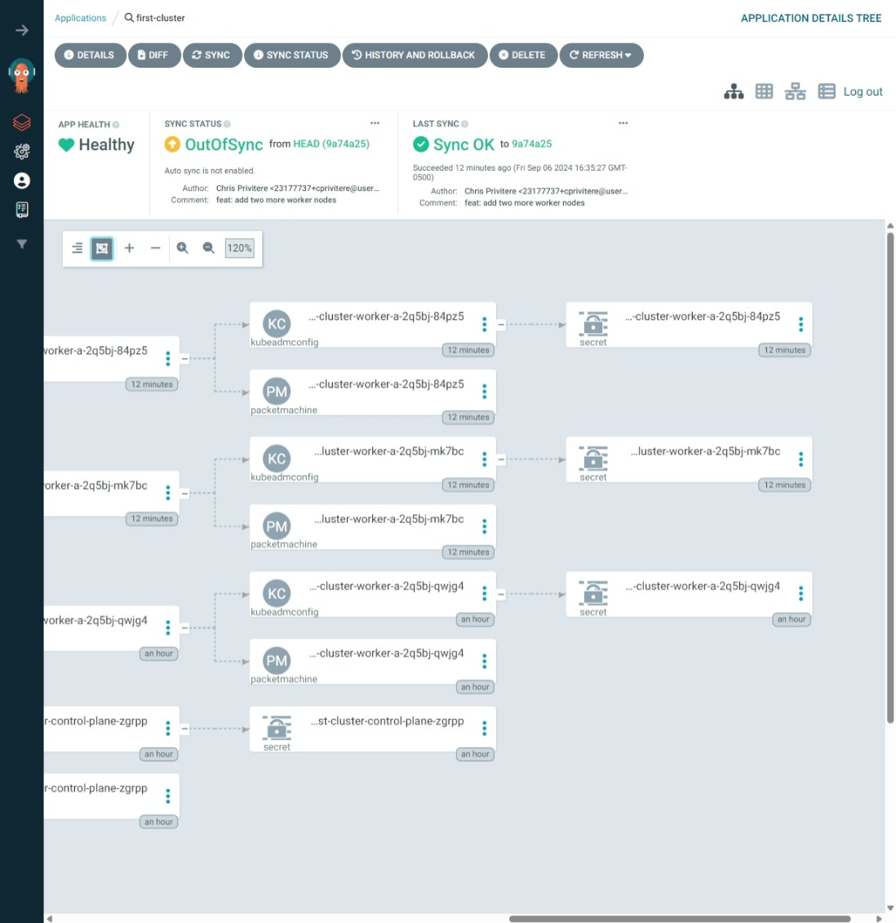
Also, it has a GUI

Slide 34
Resources
Cluster API Book is your best place to start
https://cluster-api.sigs.k8s.io/user/quick-start.html
Argocd documentation
https://argo-cd.readthedocs.io/en/stable/

